Slide 1
Литература
Forecasting: Principles and Practice, the Pythonic Way - https://otexts.com/fpppy/ (2025 год)
Переработка fpp3 (https://otexts.com/fpp3/) на python https://github.com/zgana/fpp3-python-readalong/tree/master и тут https://f0nzie.github.io/hyndman-bookdown-rsuite/
https://github.com/Beliavsky/TimeSeriesAnalysisBooks - книги по анализу ВР
https://github.com/Ian729/AI6123-TIME-SERIES-ANALYSIS - книга по анализу ВР на R 2015
https://github.com/qingsongedu/awesome-AI-for-time-series-papers - статьи по анализу ВР до 2024
https://github.com/thuml/Time-Series-Library - Библиотека анализа ВР
https://ej.hse.ru/data/2010/12/31/1208182168/06_02_07.pdf

Slide 2
Литература
Forecasting with Python Tutorials https://cienciadedatos.net/en/forecasting-python
https://darrenjw.github.io/time-series/intro.html
Luminaire https://zillow.github.io/luminaire/tutorial/dataprofiling.html https://medium.com/zillow-tech-hub/automatic-and-self-aware-anomaly-detection-at-zillow-using-luminaire
https://ranalytics.github.io/tsa-with-r/ - Аанализ ВР при помощи R
https://education.yandex.ru/handbook/ml/article/vremennye-ryady
https://mrtunguyen.github.io/posts/time-series/time-series.html
https://dev.mrdbourke.com/tensorflow-deep-learning/10_time_series_forecasting_in_tensorflow/

Slide 3
https://github.com/unit8co/darts
Skforecast https://skforecast.org/0.16.0/ https://cienciadedatos.net/en/forecasting-python
https://github.com/linhhlp/Scalable-Machine-Learning-for-Small-Teams/
https://robjhyndman.com/hyndsight/python_time_series.html - обзор реализаций методов на python
https://openforecast.org/adam/
https://github.com/qingsongedu/awesome-AI-for-time-series-papers
https://www.sciencedirect.com/science/article/pii/S0169207021001758
http://repo.darmajaya.ac.id/4781/1/Time%20Series%20Analysis_%20Forecasting%20and%20Control%20%28%20PDFDrive%20%29.pdf

Slide 4
https://www.statslab.cam.ac.uk/~rrw1/timeseries/t.pdf
https://s-ai-f.github.io/Time-Series/time-series-basics.html#what-is-a-time-series
https://bookdown.org/JakeEsprabens/431-Time-Series/forecasting.html
https://smac-group.github.io/ts/fundtimeseries.html
https://civil.colorado.edu/~balajir/CVEN6833/lectures/wwts-book.pdf
https://mse.msu.ru/wp-content/uploads/2021/03/%D0%92%D0%B2%D0%B5%D0%B4%D0%B5%D0%BD%D0%B8%D0%B5-%D0%B2-%D0%B0%D0%BD%D0%B0%D0%BB%D0%B8%D0%B7-%D0%B2%D1%80%D0%B5%D0%BC%D0%B5%D0%BD%D0%BD%D1%8B%D1%85-%D1%80%D1%8F%D0%B4%D0%BE%D0%B2-1.pdf
https://dl.leima.is/time-series/
https://www.kaggle.com/code/prashant111/complete-guide-on-time-series-analysis-in-python
https://medium.com/data-science-at-microsoft/time-series-forecasting-part-3-of-3-introducing-auts-adaptive-univariate-time-series-dfd7555ca8d4
https://www.openforecast.org/adam/state-space-form-of-ets.html
https://livebook.manning.com/book/modern-time-series-analysis-in-python/c
https://ranalytics.github.io/tsa-with-r/
https://towardsdatascience.com/forecast-multiple-time-series-like-a-master-1579a2b6f18d/
https://www.stat.berkeley.edu/~aditya/resources/FullNotes248Spring2022TimeSeries.pdf
https://www.stat.berkeley.edu/~ryantibs/timeseries-f23/
https://stat153.berkeley.edu/spring-2025/lab5 - интерактивно
https://fish-forecast.github.io/Fish-Forecast-Bookdown/
https://xiaorui.site/Forecasting-and-Time-Series-Methods/
https://www.econometrics-with-r.org/16.1-vector-autoregressions.html
https://bookdown.org/

Slide 5
Фреймворки
https://github.com/ddz16/TSFpaper - статьи по ВР до 2025
https://github.com/lmmentel/awesome-time-series – подборка большого количества всего по ВР
https://nixtlaverse.nixtla.io/statsforecast/index.html - статистические методы, включая авто- ETS, atuoARIMA и итд.
https://nixtlaverse.nixtla.io/mlforecast/index.html - машинное обучение
https://nixtlaverse.nixtla.io/neuralforecast/docs/getting-started/introduction.html - предсказание при помощи нейронных сетей
https://skforecast.org/0.16.0/index.html - отличный оригинальный фреймворк для предсказания ВР с машинным обучением
https://unit8co.github.io/darts/ - очень объемный фреймворк – почти все типичные задачи ВР
https://www.sktime.net/en/stable/ - большая подборка методов в формате sklearn-like
https://robjhyndman.com/hyndsight/python_time_series.html - список фреймворков от Robj Hyndman
https://www.sciencedirect.com/science/article/pii/S0169207021001758 Forecasting: theory and practice Review 2022

Slide 6
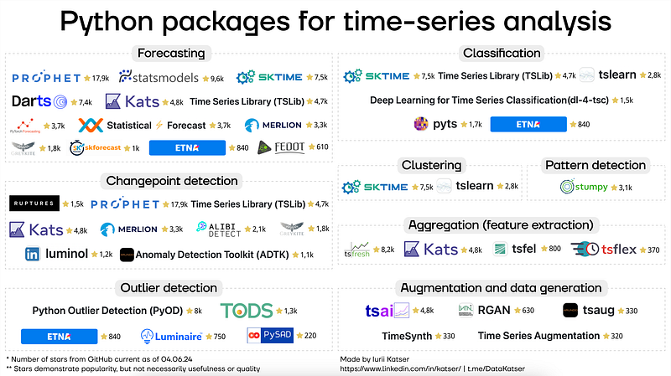
https://readmedium.com/a-list-of-python-packages-for-time-series-analysis-c883bcadcc58

